Slide 1

PROJECT MEUMORIES
Centre for professional training “Dessita” – the Bulgarian partner in

Slide 2
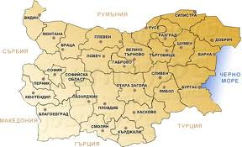
Where are we from?
The Bulgarian partner Dessita comes from Gabrovo city, which is situated in the centre of Bulgaria, at the Northern foothills of Stara planina mountain

Slide 3
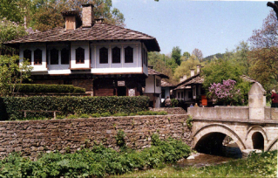
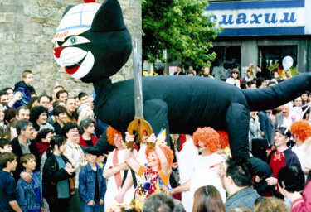
What is Gabrovo famous for?
The Ethnographic museum Etar is the first open air museum in Bulgaria, which shows the architecture, the life style and the economic past of Gabrovo region during the Revival period.
Gabrovo is the Bulgarian capital of humour and satire and is famous for its jolly people and the Carnival in May

Slide 4
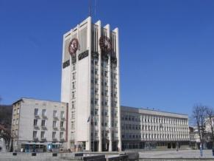
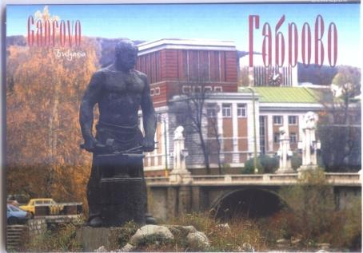
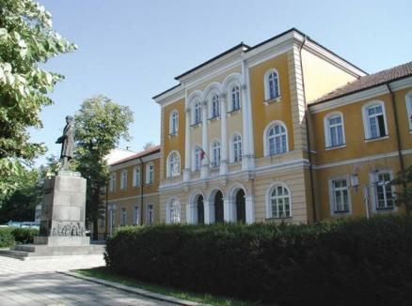
What is Gabrovo famous for?
The town of Racho the Blacksmith
A legend says that a blacksmith called Ratcho
settled by the Yantra river. Since a great yoke-elm
(in Bulgarian gabar) soared up by the fireplace of
Racho the Blacksmith, they called the new
settlement Gabrovo
The first Bulgarian secular school – established in 1835 by Vassil Aprilov

Slide 5
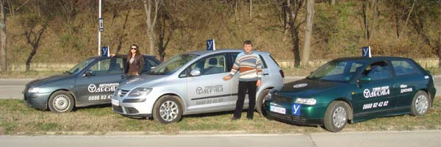
About Dessita in brief
Centre for professional training “Dessita” was established in 1991
It is a private company which offers vocational training to adults for 20 different professions
It specializes in providing lessons for getting a driving license – up to now about 10 000 drivers got qualified in our Center

Slide 6
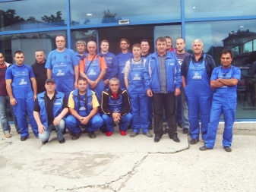
Types of courses we offer
The Centre for professional training “Dessita” is licensed by the National Agency for Vocational Education and Training. We offer more than 20 training courses for acquiring a profession or additional qualification:
business administration,
computers,
building and fitting,
accountancy,
hotel management,
cosmetics, hair-dos,
office assistant
salesman
barman and waitor, etc

Slide 7
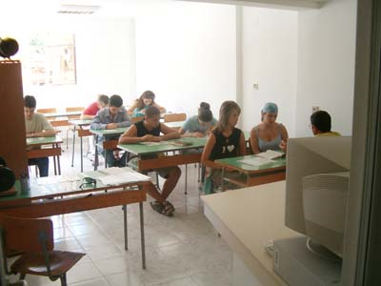
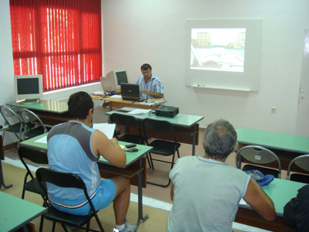
Material basis
- two administrative offices – one of which in the city centre
- 4 classrooms equipped with multimedia and laptop for the teacher. Their capacity is for 14, 20, 20 and 38 people
- 7 training automobiles, 2 motorbikes, 1 bus and 1 truck

Slide 8
Membership
Dessita is a member of:
The Association for Vocational Training and Qualification
The Bulgarian Association of Motoring Training Centres
The Association of motorists’ qualification in Bulgaria

Slide 9
Projects
Close cooperation with the Labour Office under the Programs for Temporary Employment and Improvement of Unemployed people’s qualifications
48 people trained for the professions of shop-assistant and automobile technics only in the last year and about 200 in the last 5 years
Among them people from the risk groups: single mothers, elderly people, disabled people

Slide 10
Projects
A project connected with the corporative social responsibility of the company:
“I drive safe! How about you?”
Two open days of safe driving
5 campaigns for ethics on the road, tolerance, responsible behavior and care for the environment
brochure with advice for drivers and a sticker

Slide 11

Projects
The sticker for the safe driving campaign

Slide 12

Projects
A project that started this year and Dessita is the leading partner in it is connected with environment protection and the use of RES:
Modernizing of 5 ECO-carwashes in Gabrovo with solar supply of the electrical system and heating of the water
Financed by the Global Ecological Fund
Aims to popularize the use of solar potential as ecological energy source
One of the carwashes belongs to “Dessita”
A Handbook with rules for ecological driving shall be published

Slide 13
OUR EXPECTATIONS
TO TRAIN 10 PEOPLE AGED 45-60 IN BASIC ENGLISH AND COMPUTERS (TO USE SKYPE, INTERNET, SEARCH ENGINES, MAILS, TO MAKE WORD DOCUMENTS WITH MEMORIES, TO DOWNLOAD AND EXCHANGE PICTURES)
TO MEET THEM WITH THEIR EU PEERS IN ORDER TO EXCHANGE IDEAS, MEMORIES AND EXPERIENCE
TO SOCIALIZE THEM

Slide 14

Thank you for the attention! www.desita-ivandjenev.hit.bg desita_ivandjenev@abv.bg
Bulgaria, 5300 Gabrovo,
105 Stefan Karadzha str. phone: +359 66 806073

