Slide 1

EDUCAnet Praha
Kick-off meeting
Project Meumories
6.-8.10.2010

Slide 2
About us
We are a network of private secondary schools
The schools are spread all over the Czech republic
We are specialized in ICT and languages
We have lots of different projects (LLP, ESF etc.)

Slide 3
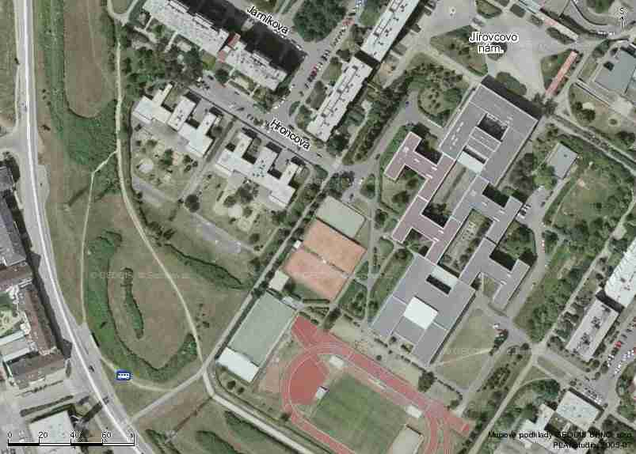
Our school from the air

Slide 4
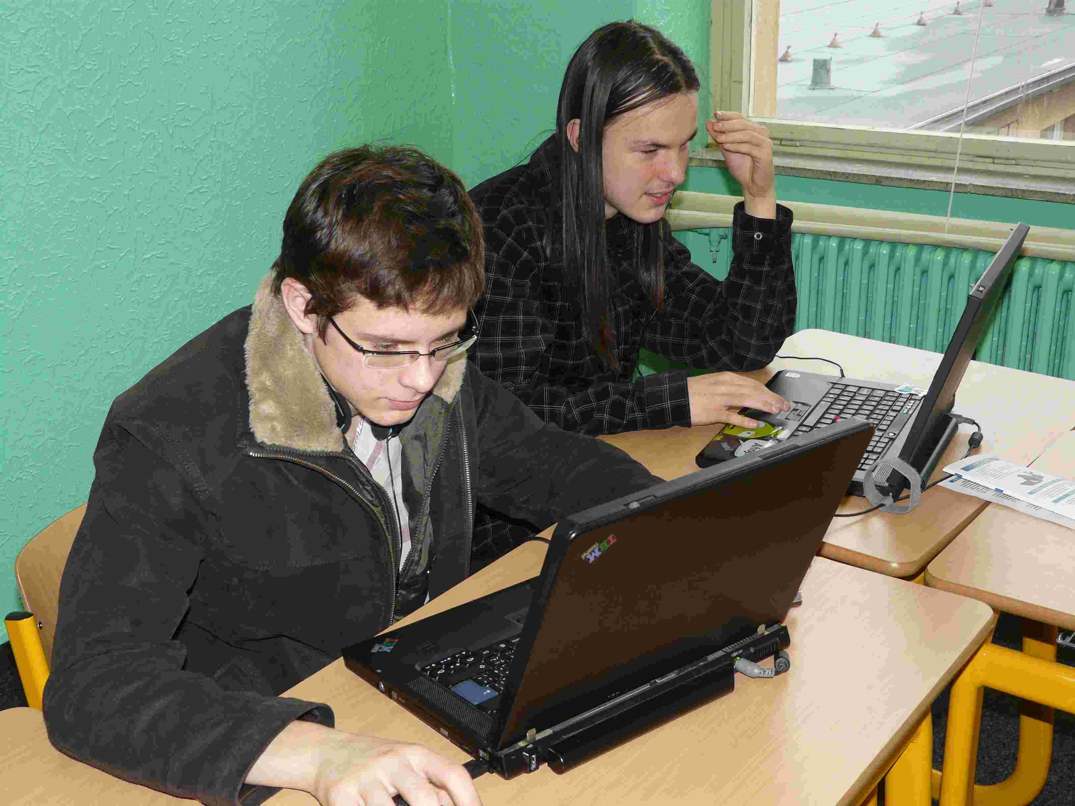
About our school
We have 240 students
We have on-line education (good ICT equipment)
W cooperate with a lot of local and inetrnational institutions

Slide 5
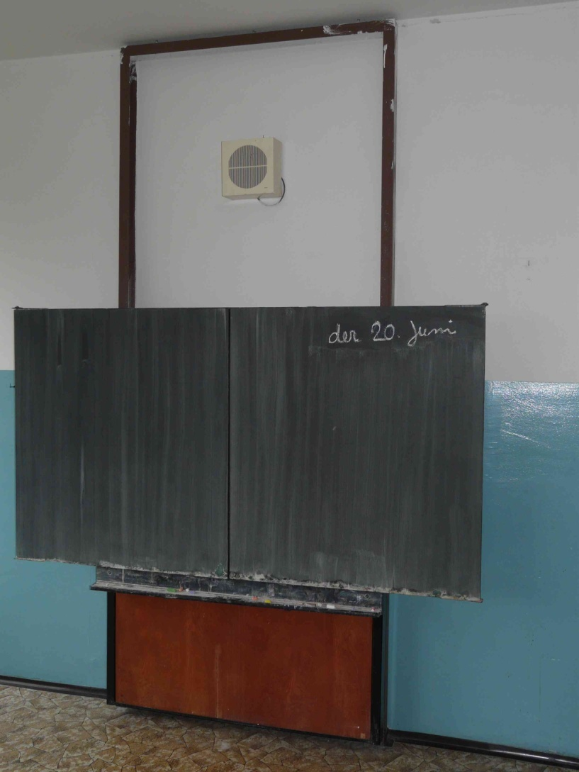
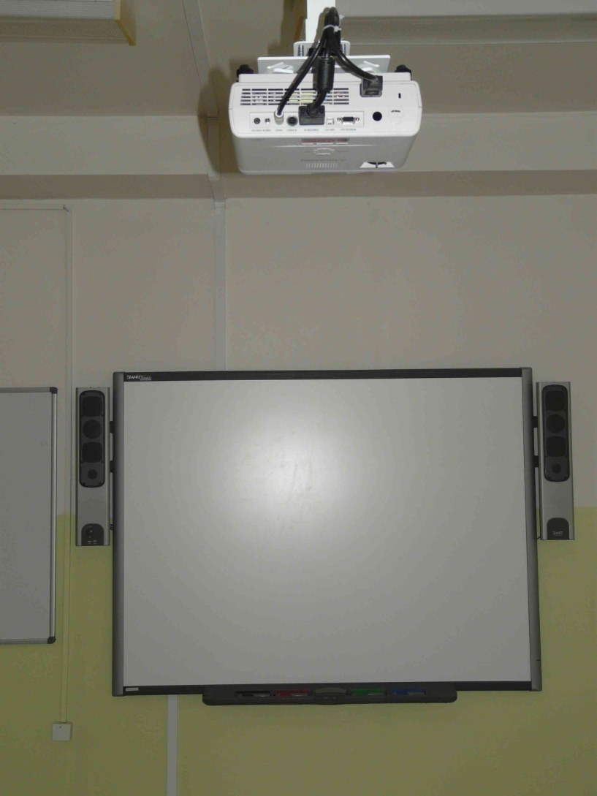
ICT equippment
All students have a notebook
All classrooms have a smartboard
Langage classrooms – LCD TV

Slide 6
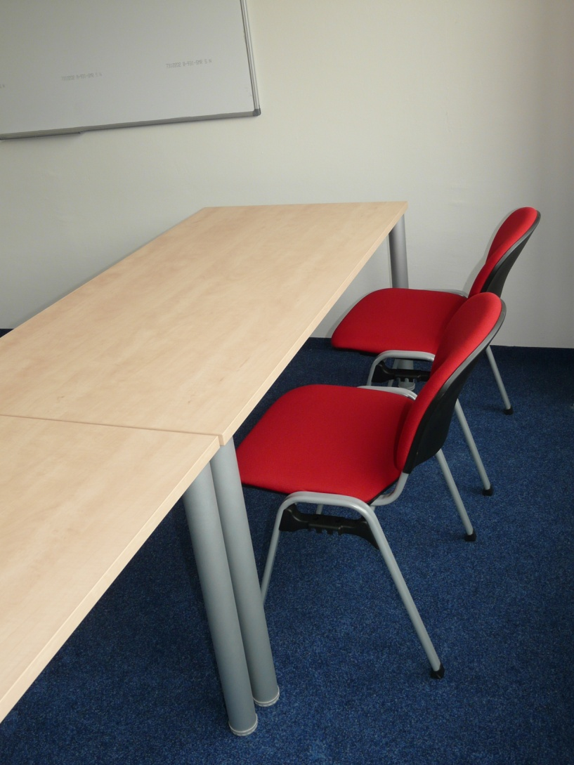
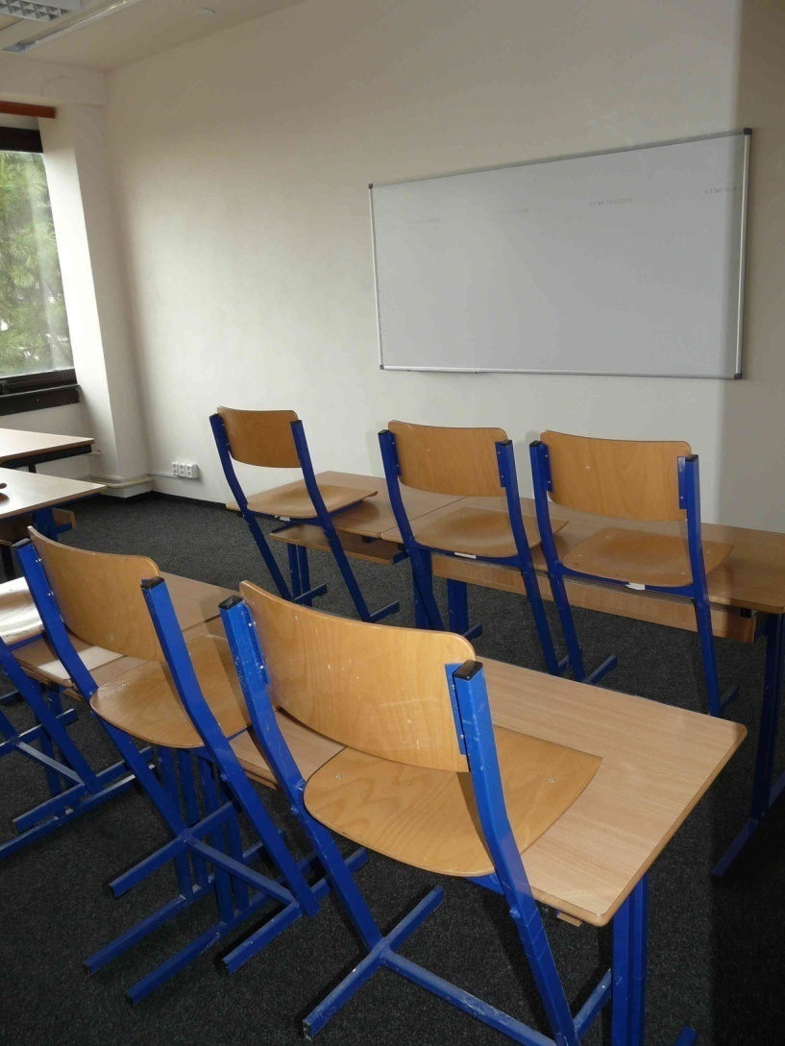
Language classrooms
.

Slide 7
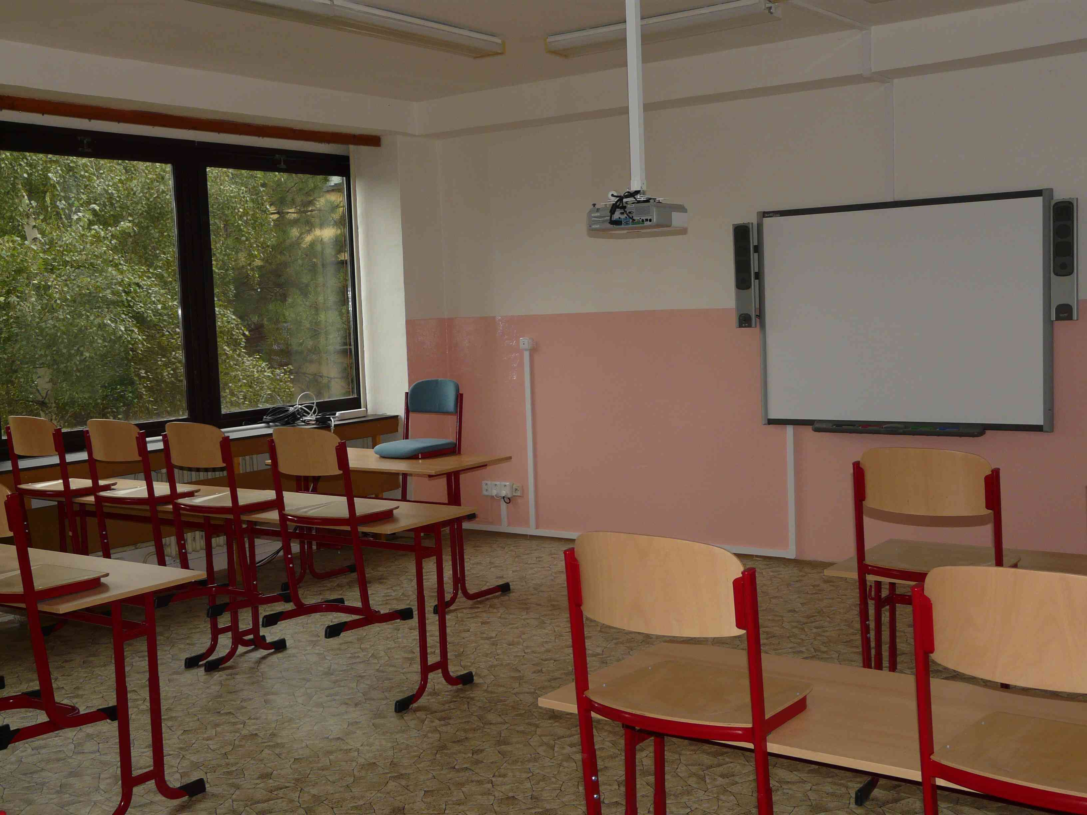
Our classrooms

Slide 8
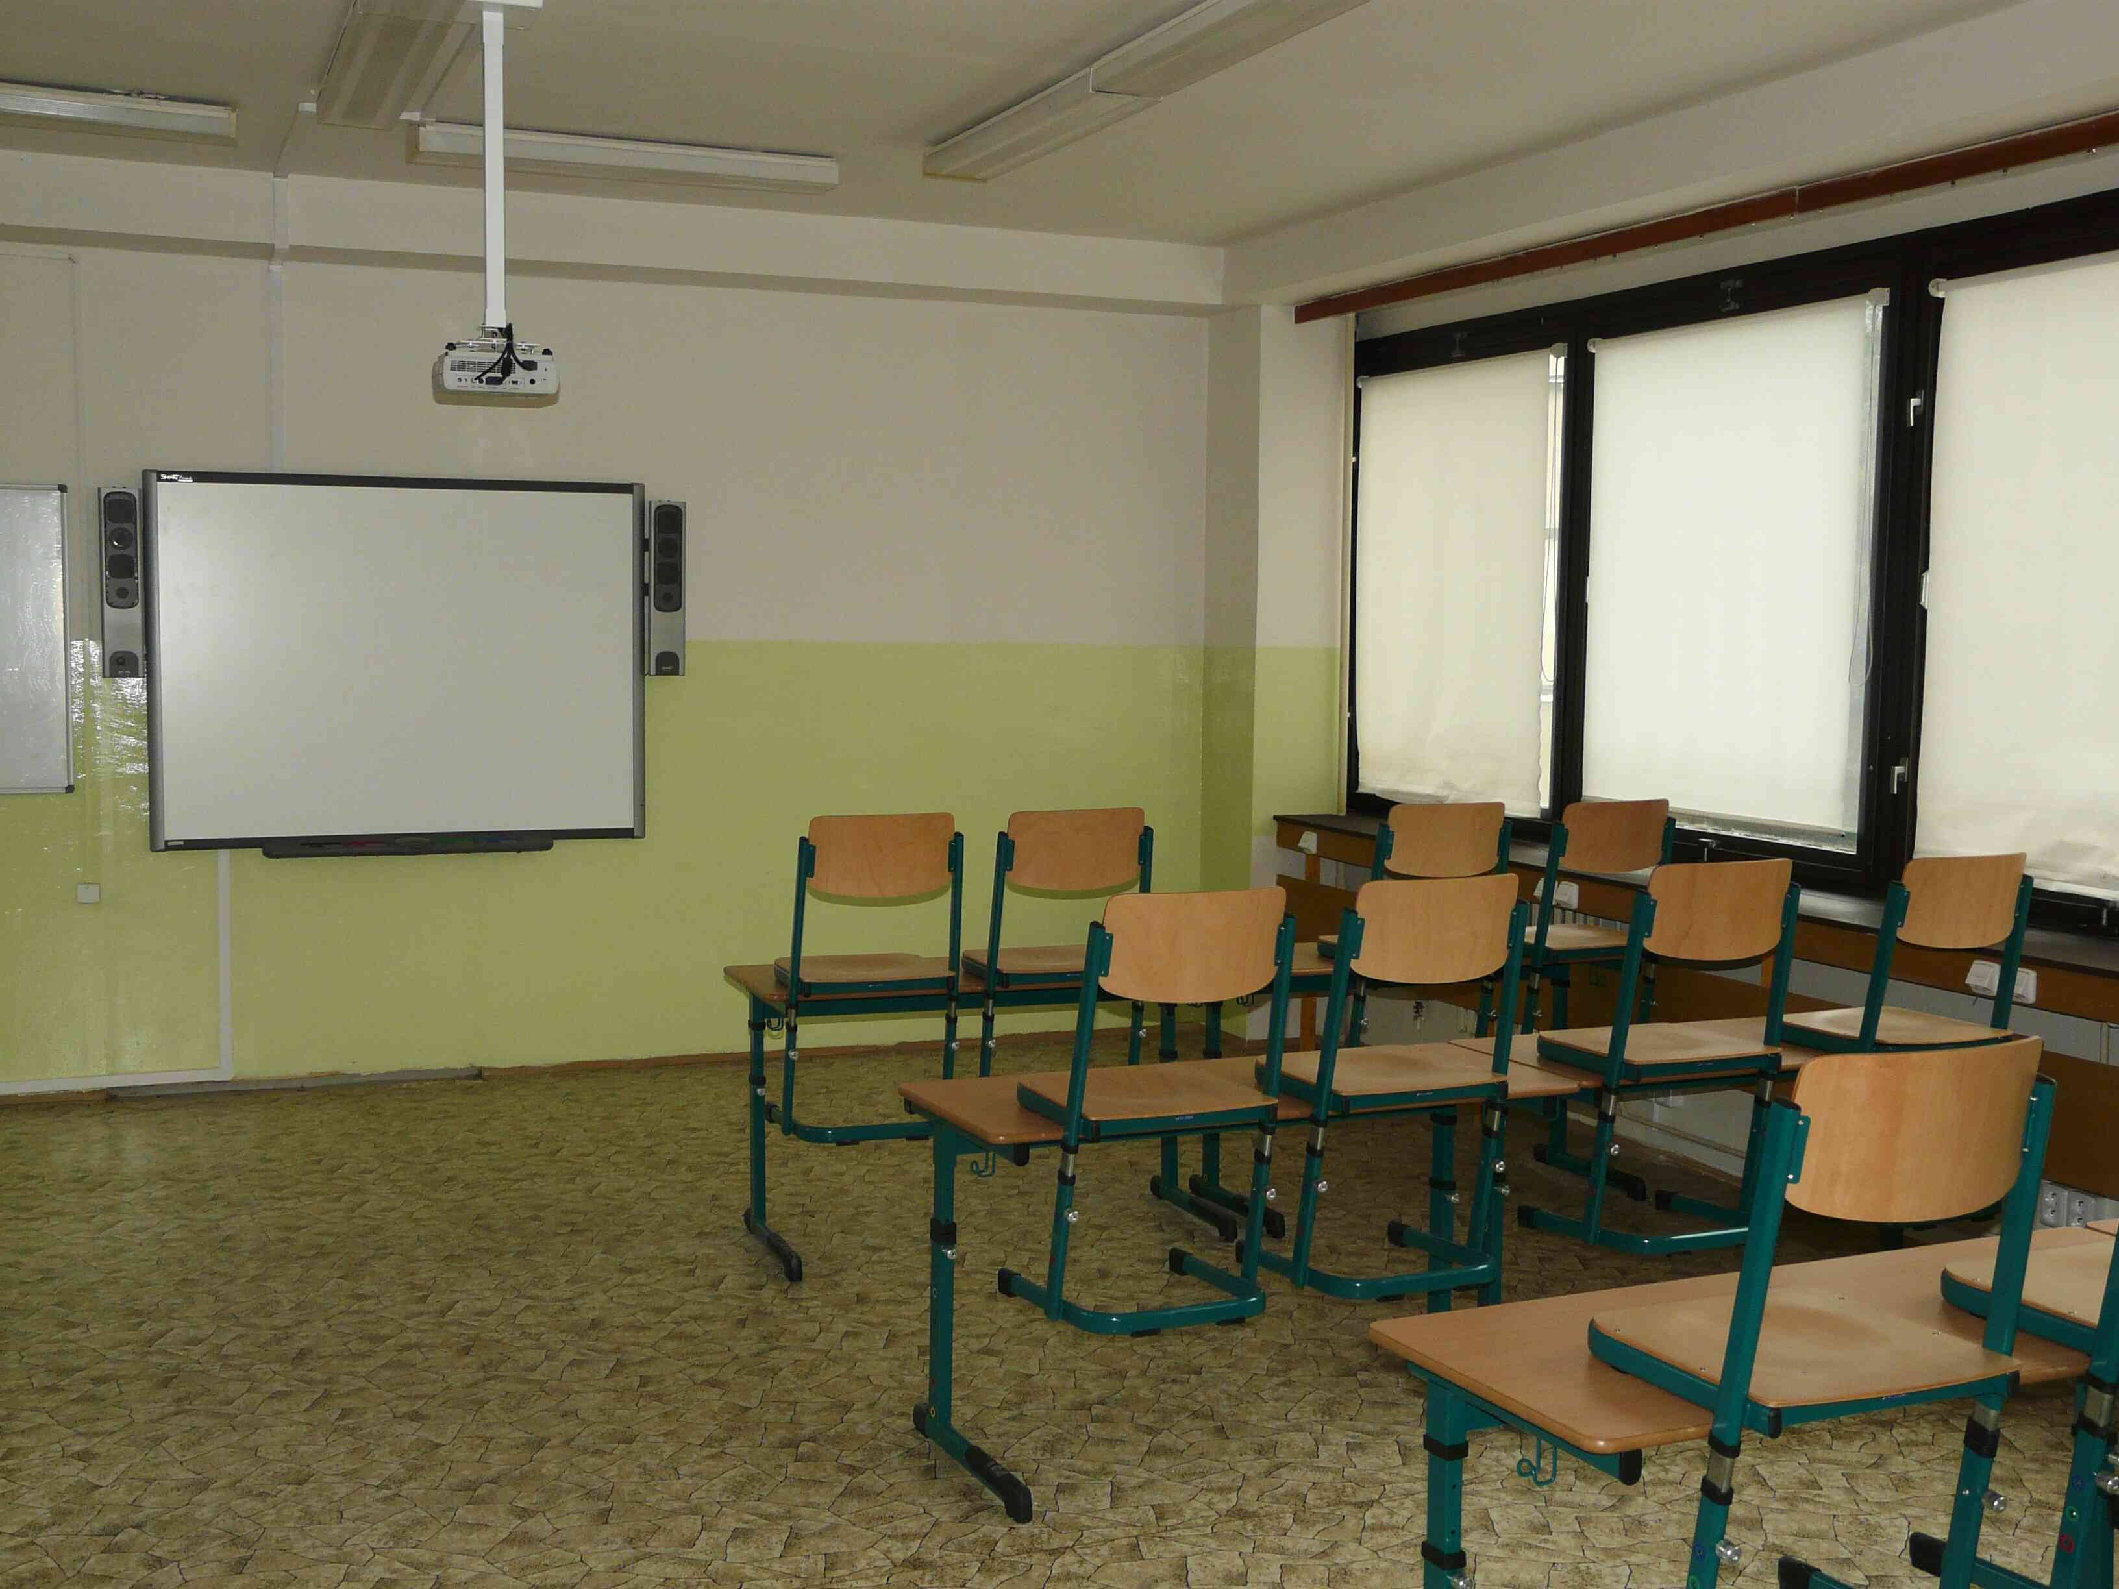
Our classrooms

Slide 9
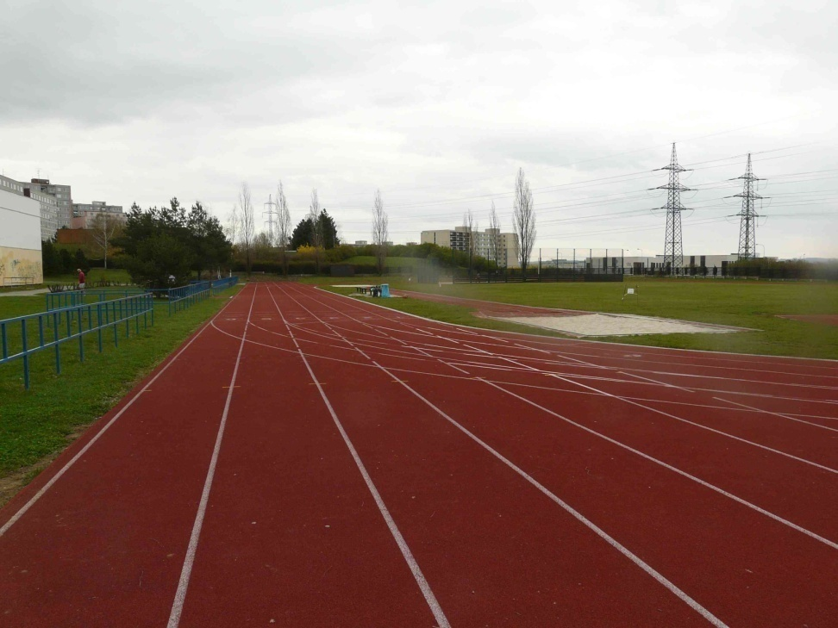
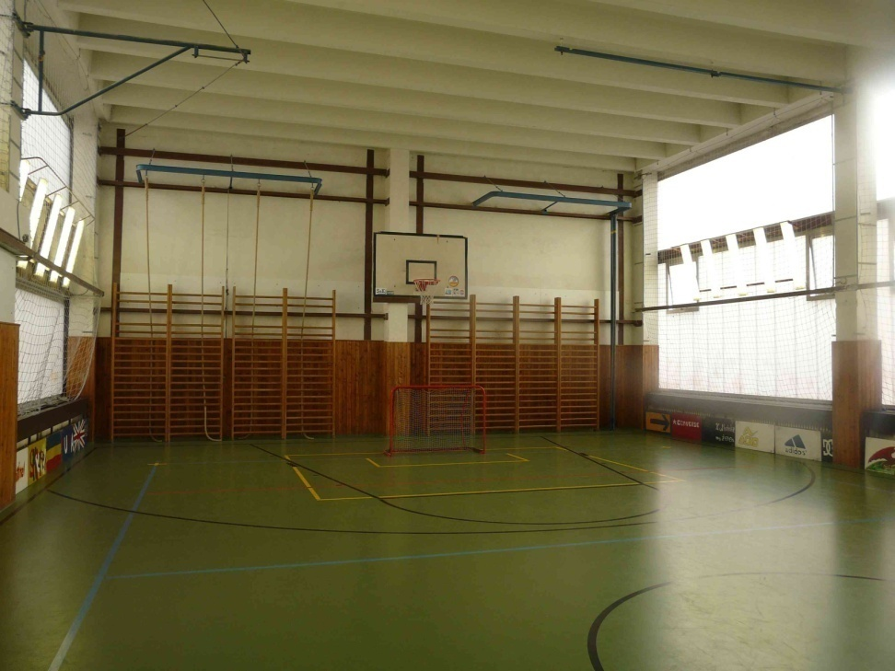
For sports

Slide 10
About me
I work as a project coordinator
I am responsible for fundrising
I create, coordinate and manage different projects
I work for six school of our network
I was a Grundtvig project coordinator about seniors (2007-2009)

Slide 11

Prague school projects
Project „Meumories“ (Grundtvig)
Project „Toward a Common Understanding of Democracy in Europe“ (Comenius)
Project Innovation of school education (ESF)
Project „management skills“

Slide 12
Project Meumories
Cooperation with local retirement home, local NGO, local senior club
Language courses for seniors – students will teach
ICT courses for seniors – students will teach
Students and seniors will create a memorz book
Social activites with the cooperation of KC Zahrada (Cultural center Garden)

Slide 13




Our partners

Slide 14
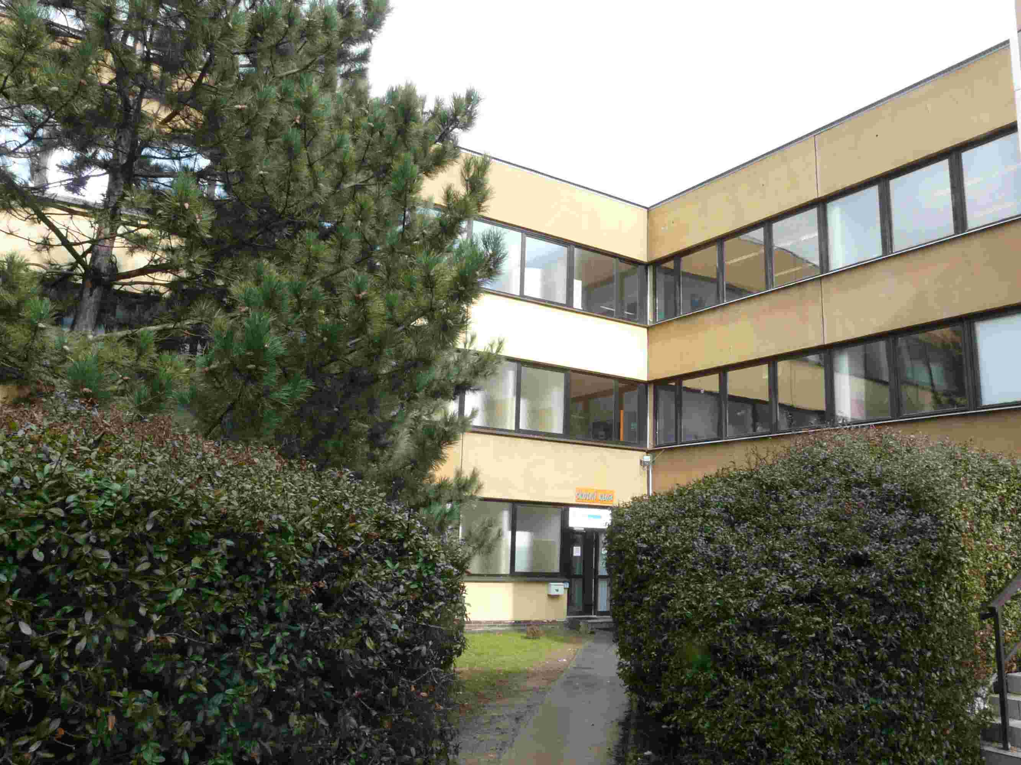
Contacts
phones:
  774 073 319 (Lenka Pacovska)
e-mail: lenka.pacovska@educanet.cz
Veronika.bartosova@
educanet.cz
web: praha.educanet.cz

