Slide 1

THE CHAMBER OF COMMERCE AND INDUSTRY OF ARLES, FRANCE
Created in 1909, the CCI is managed by industrialists, storekeepers and service providers who must be installed in the area of Arles.
There are 36 municipalities inside this area.

Slide 2
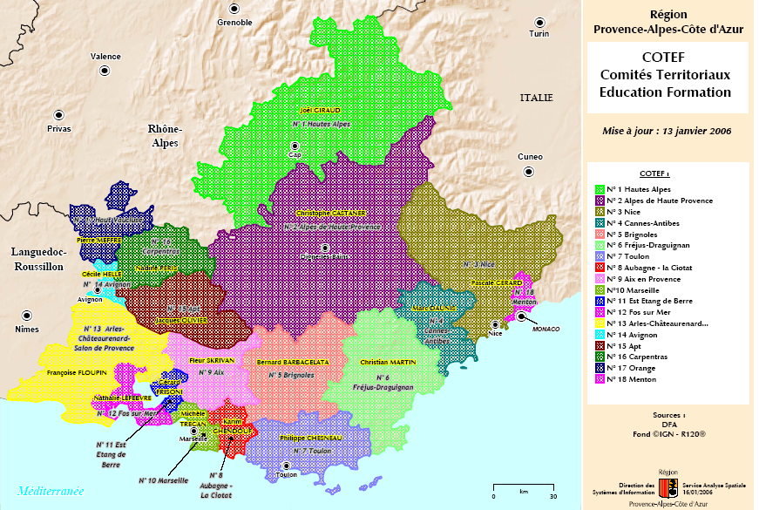
SOUTH OF FRANCE

Slide 3
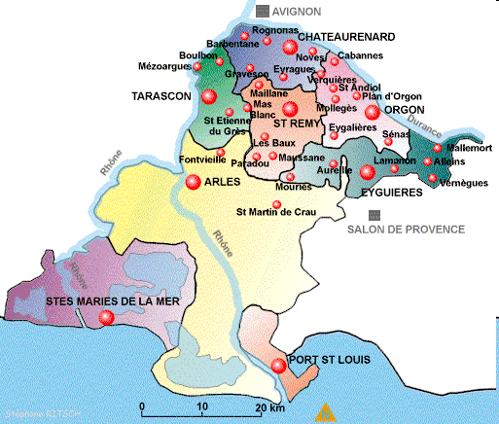
AREA OF ARLES, FRANCE

Slide 4

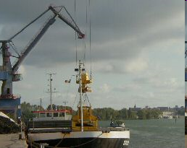



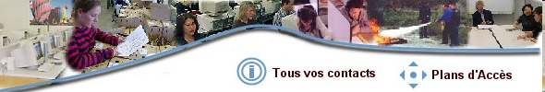
MAIN ACTIVITIES

Slide 5
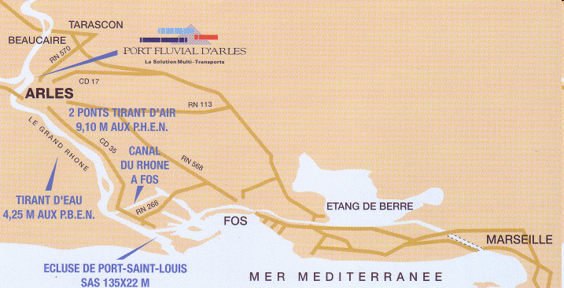
RIVER PORT OF ARLES
This is the first river port where boats can cross. This river port welcome small and big ships during connexions by road.
There are more than 30 connexions to EUROPE and AFRICA, e.g.
This River Port receive connexions from the railway and there are more than 4 000 m2 of warehouses and business buildings to welcome enterprises, firms.
They are all in fields of the logistics and transports.

Slide 6
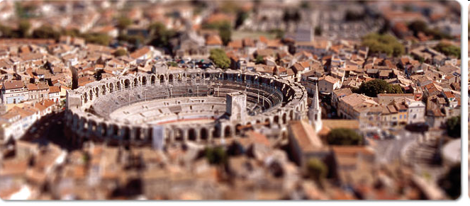
CONGRESS CENTER
More than 2700 m² Open space.
10 rooms of different size ( from 20 chairs to 200 chairs ).
A large place with a inside free without pillars
A quick connexion from motorway and of train and of aeroport.
A large free parking for 250 cars and trucks.
A friendly team of 10 people
A very nice surrounding with monuments, like the old bridge, arena, theatre, museums, and painting of VAN GOGH
A blue sky, a sweet winter and a lot sun in a peaceful surroundings

Slide 7





LOGOS OF ACTIVITIES FROM THE VOCATIONAL TRAINING CENTER

Slide 8

VOCATIONAL TRAINING CENTER
Contact :
Delphine LAFOREST
INDIVIDUAL TRAINING AND E-LEARNING WORKSHOP OF ARLES
APP - CFC
Chemin du Temple
13200 ARLES
Tél. : 04 90 99 46 60

Slide 9
Program
Software : Word, Excel, Free software « Impress », Internet,
Improve basics skills in French,
Improve skills in Accounting, Mathematics, logic and geometry,
Improve skills in General cultural surrounding of France and the area,
Training and learning to prepare Competition public,
Training courses in English, Spanish, german and Italian.
You are
Unemployed people,
Workers,
Handicapped worker,
Trainees,
Individual without funding,
Senior citizens,
Students.

Slide 10

VOCATIONAL TRAINING CENTER
Contacts :
Frédéric MOYNE
Sylvie GAUZARGUES
POINT ALTERNATION of CCI of Arles
Chemin du Temple
ZI Nord, 13 200 Arles
Tél. : 04.90.99.46.51

Slide 11
This department is used to give and receive informations to learners and employers.
Pupils, students, unemployed people can find a help to meet enterprises, managers, directors.
This department helps to fill documents and public files. E.g :A company wants to hire a candidate and involve a specific training
Actions
Give and send informations to discover a job, to knows legal ways to employ someone, to look for a school, high school, Professional school or an university.
We help enterprises within their looking for learners, in order to contract a job with a learning skills inside the firm.
Who can use this advices
Learners,
Enterprises,
Sales department,
Restaurants, Hotels,
Industrial firm,

Slide 12
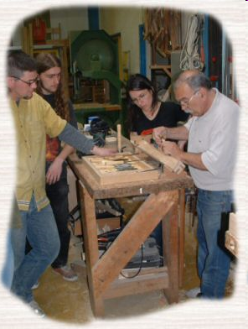



OTHERS ACTIVITIES
Centre de Formation Continue Arles ZI Nord Chemin du Temple 13 200 Arles Tel : 04.90.99.46.00 Fax : 04.90.93.91.09 www.emploi-formation.arles.cci.fr | Centre de formation Équestre La Cité du Cheval - Quartier Kilmaine 13 150 Tarascon Tél. : 04.90.91.37.05 Fax : 04.91.43.58.67 www.equestre.arles.cci.fr | Centre de Formation Continue Châteaurenard (Métiers du bois) 7 rue Georges Bizet 13 160 Châteaurenard Tel : 04.90.94.02.30 Fax : 04.90.94.68.40 www.formationbois.arles.cci.fr
Espace ouverts d’éducation Permanente Z.I Nord 23 Chemin des Moines 13200 Arles Tél : 04 90 99 47 00 Fax : 04 90 93 03 15 www.poleira.fr |  | SUPINFOCOM Arles 2 route de Crau 13 200 Arles Tél : 04.90.52.11.00 - Fax : 04.90.52.11.01 www.supinfocom-arles.fr

Slide 13

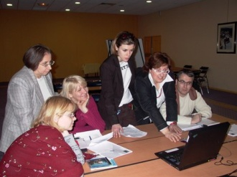
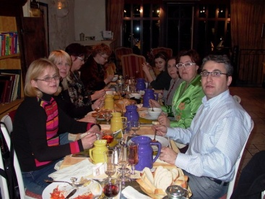
EUROPEAN PROJECTS
YEAR | PROGRAM | PARTNERS | COUNTRIES
2004-2005 | Partenariat Éducatif Grundtvig Action 2 On apprend l’anglais | L.U.E.T.E.C MOTERUS INFORMACIJOS CENTRAS | 1-ITALIA 2- LITHUANIA

Slide 14

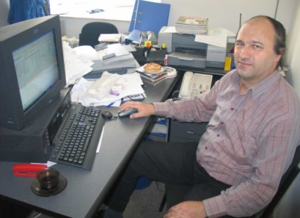
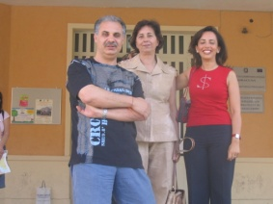
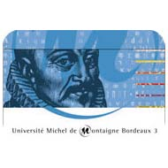
EUROPEAN PROJECTS
YEAR | PROGRAM | PARTNERS | COUNTRIES
2005-2006 | Partenariat Educatif Grundtvig Action 2 Échanger sur les méthodes d'éducation des adultes | ASOCIATA PENTRU INVATARE PERMAENTA XIV ISTITUTO COMPRENSIVO UNIVERSITE 3 MONTEIGNE | 1-ROUMANIA 2- ITALIA 3 - France

Slide 15

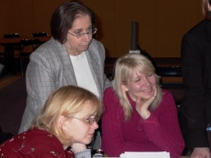
EUROPEAN PROJECTS
YEAR | PROGRAM | PARTNERS | COUNTRIES
2005-2006 | Partenariat Educatif Grundtvig Action 2 On apprend l’anglais | L.U.E.T.E.C UNIVERSITA DELLA TERZA ETA MOLA DI BARI MOTERUS INFORMACIJOS CENTRAS VARKAUDEN LUKION ALKULSLINJA | 1-ITALIA 2-LITHUNIA 3-FINLAND

Slide 16

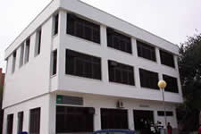
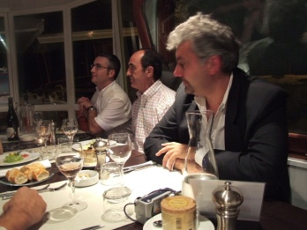
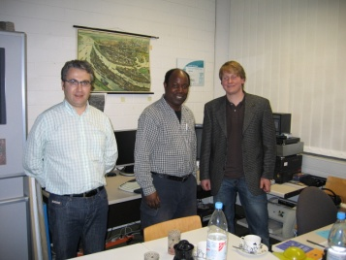
EUROPEAN PROJECTS
YEAR | PROGRAM | PARTNERS | COUNTRIES
2006-2007 | Partenariat Educatif Grundtvig Action 2 Échanger sur les méthodes d'éducation des adultes | ASOCIATA PENTRU INVATARE PERMAENTA XIV ISTITUTO COMPRENSIVO UNIVERSITE 3 MONTEIGNE INSTITUTO PROV FORMACION ADULTOS COCOF I.T.S | 1- ROUMANIA 2 - ITALIA 3 - France 4 - SPAIN 5 - BELGIUM 6 -GERMANY

Slide 17

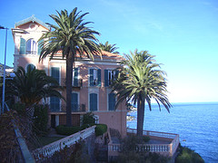
EUROPEAN PROJECTS
YEAR | PROGRAM | PARTNERS | COUNTRIES
2007-2009 | Partenariat Educatif Grundtvig R.E.P.A.I.R.E | INSTITUTO PROV FORMACION ADULTOS COCOF I.U.T MICHEL DE MONTEIGNE INSTITUT POUR LE DEVELOPPEMENT | SPAIN BELGIUM FRANCE CORSE

Slide 18
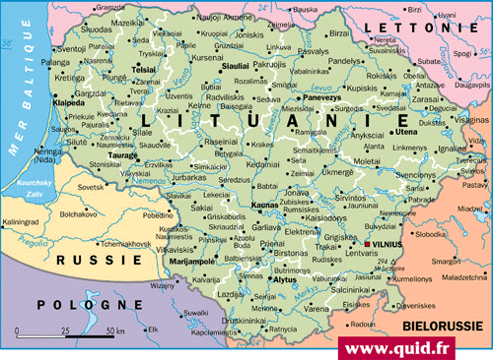
EUROPEAN PROJECTS
YEAR | PROGRAM | PARTNERS | COUNTRIES
2009 | Grundtvig preparatory visits | ALYTUS KOLEGIA | LITHUNIA

Slide 19
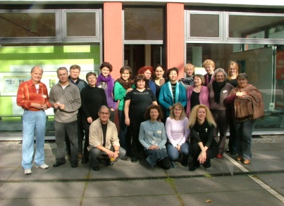
EUROPEAN PROJECTS
YEAR | PROGRAM | PARTNERS | COUNTRIES
2009 | grundtvig workshop Berlin in Europe Europe in berlin | OWEN e.V Mobile Akademie für Geschlechterdemokratie und Friedensförderung | GERMANY

Slide 20

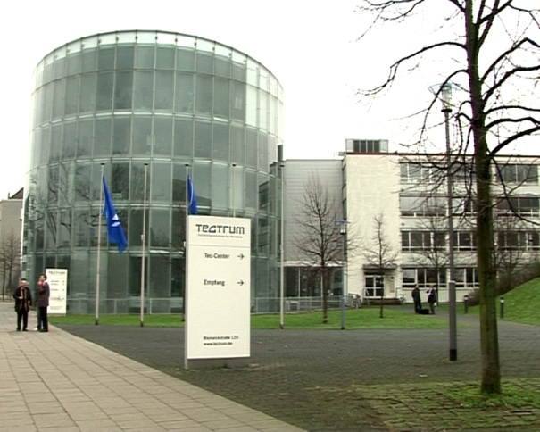
EUROPEAN PROJECTS
YEAR | PROGRAM | PARTNERS | COUNTRIES
2010 | Grundtvig Visits and Exchangesisits and Exchanges | I.T.S | GERMANY

Slide 21
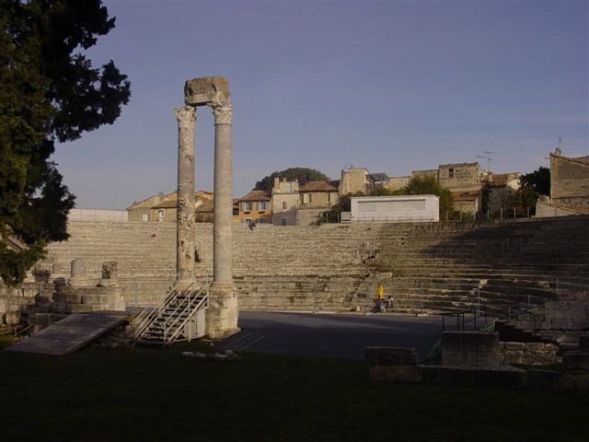
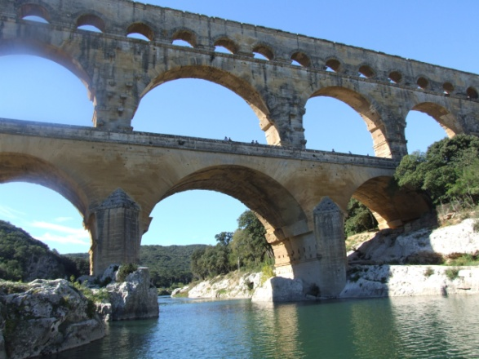
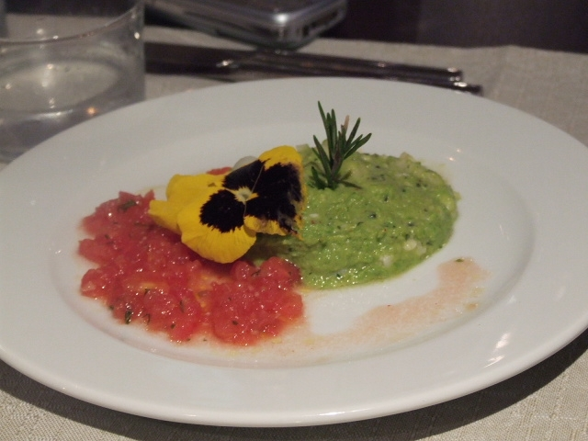
ARLES & SURROUNDINGS
Pont du Gard,
& Roman theater
French restaurants
THANKS A LOT FOR YOUR LISTENING

