Slide 1
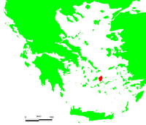
PROGRAMME GRUNDTVIG
ME-U-MEMORIES
2010-2012

Slide 2
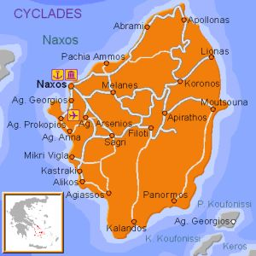
Naxos Greece
It is the biggest and largest of the Greek Islands of the Cyclades in Greece, in the Aegean Sea, located in front of Paros and near Mykonos.

Slide 3
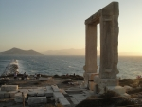
I
It is the nuptial isle of the god Dionysus
This is the marble gate called Portara

Slide 4
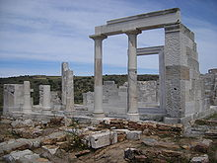
Naxos is a popular tourist destination, with several easily accessible ruins, many picturesque villages and….

Slide 5
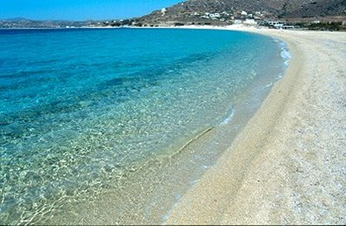
……… sandy beaches

Slide 6
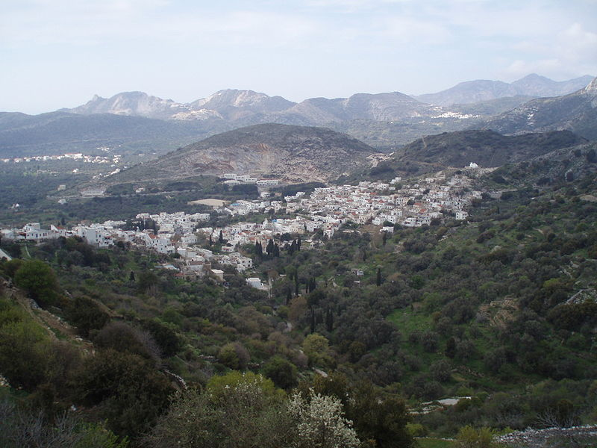
FILOTI
Filoti is situated 19 km from the capital of the island, in a beautiful valley near the mountain of Zas. It is considered by many as one of the most beautiful villages of the island. Built amphitheatrically,. All the activity of the village is concentrated around the central square with many cafés and tavernas under the shade of a huge plane tree.

Slide 7
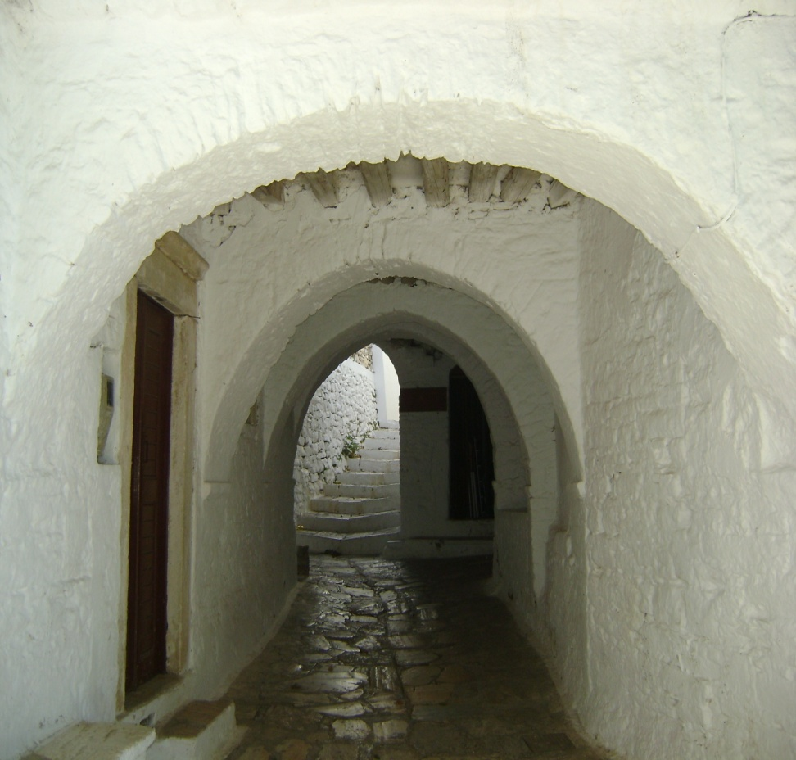
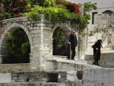
FILOTI is a traditional village with white painted houses in narrow paved streets

Slide 8
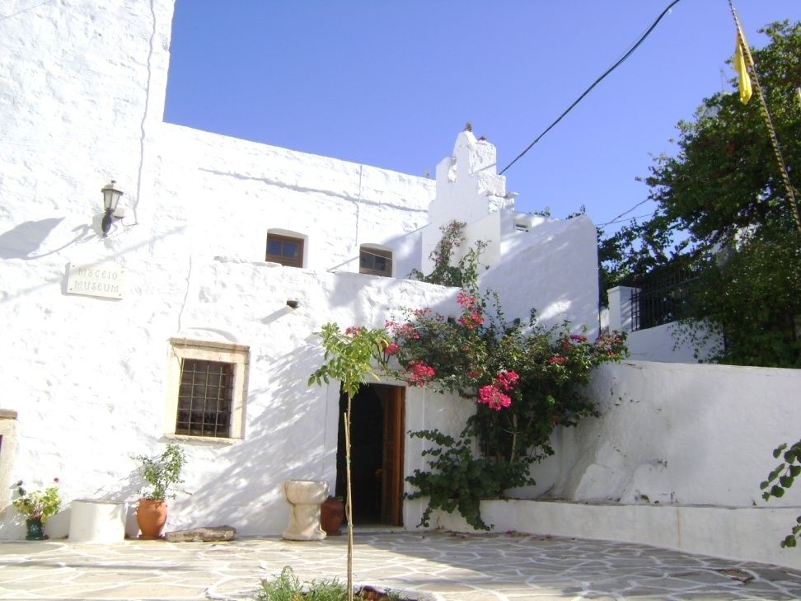
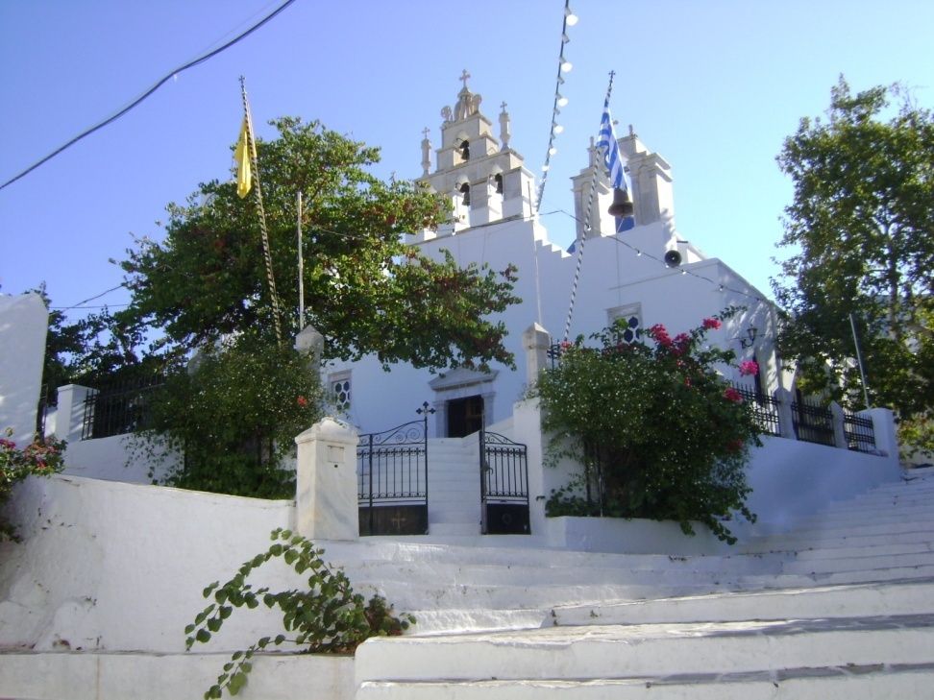
OUR ASSOCIATION

Slide 9
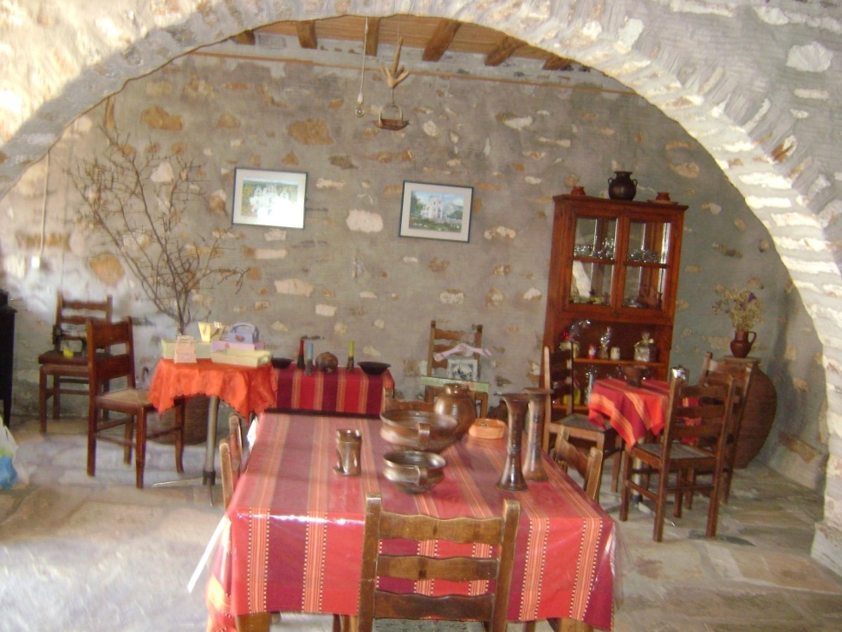
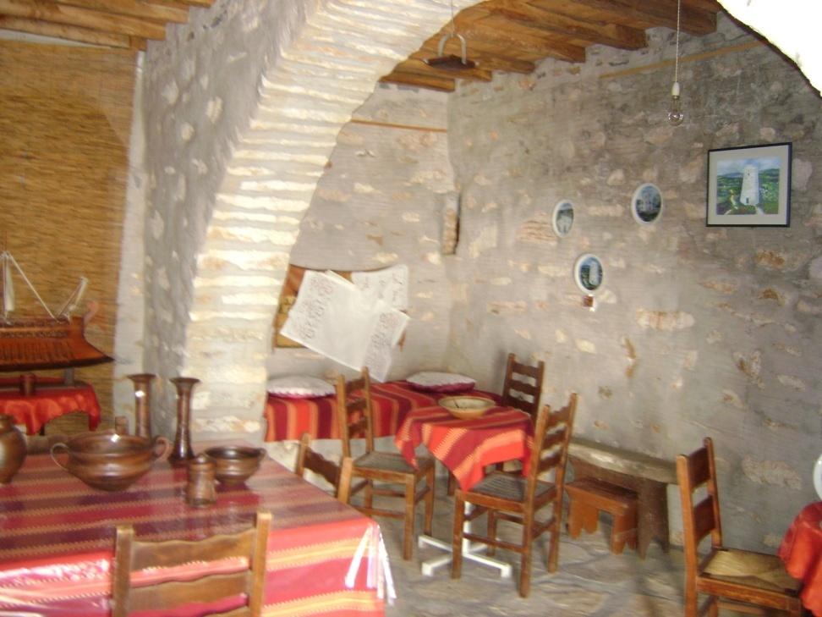
OUR WORKSHOP

Slide 10

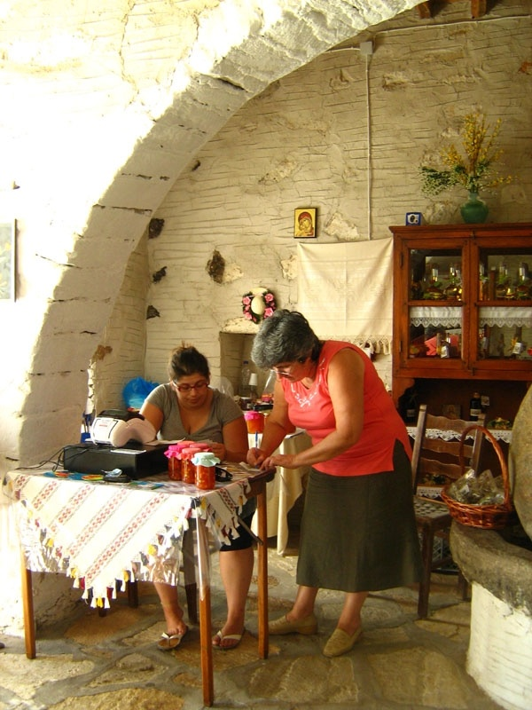
WOMEN IN ACTION

