Slide 1
Età Serena
Me(u)mories
a project
Grundtvig
2010-2012
For a fair age

Slide 2
Who we are
Età Serena was established 12 years ago to associate people in a non- profit community, involved in volunteering in Trebisacce. We are one of the most successful non-profit association in our area whose members come from the surroundings towns, too.
Economy in the local area has a rural background.
Ageing people are increasing, while young generations emigrate to northern regions.

Slide 3
Family links among generations come to disappear, so that elderly people suffer the lack of that traditional mutual help on which was based on the family system in the past times.
Field of action includes: mutual help, information, education, culture, environment, leisure time.
Our prime objective is to inform, promote and encourage members and non members to act as the protagonists of their own lives.

Slide 4
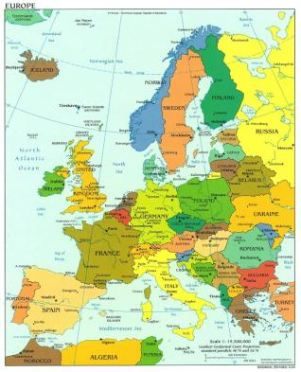
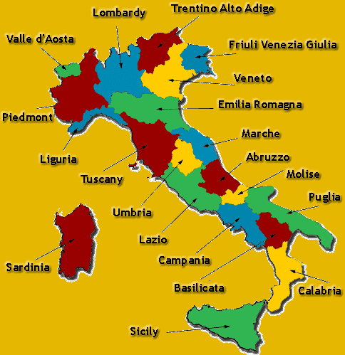
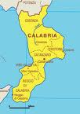
Where we are
We are located in the town of Trebisacce, Regione Calabria, in the South of Italy.
Economy in the local area has a rural background.
Global crisis involves all activities,
Ecosystem is menaced, as well as social wellbeing and people’s relationship
TREBISACCE

Slide 5
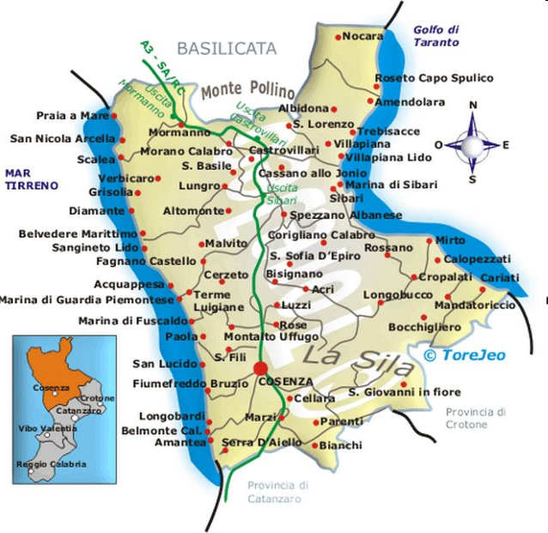

Slide 6
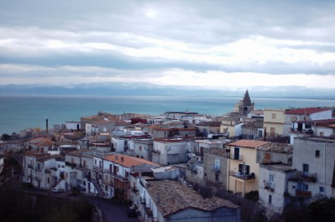
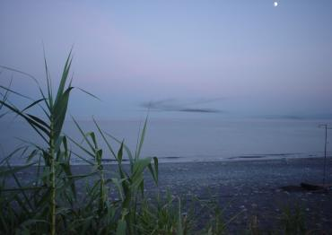
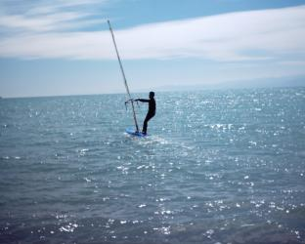
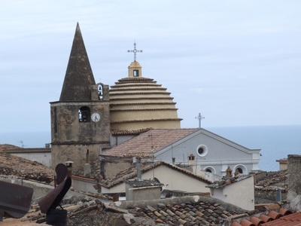
Trebisacce

Slide 7
Trebisacce
Trebisacce counts 9.023 inhabitants, they are called Trebisaccesi
The area is kmq 26,7
The historical centre is m. 75 above the sea level.
The city Hall is in Piazza della Repubblica.
The climate is graetly influenced by the morphology of the site, the plain of Sibari and Mount Pollino, that shelters the town from the northern and eastern winds and by Mount Mostarico on the north-west side of Trebisacce. The warmth of milde air is also influenced by the Sea Conio.

Slide 8
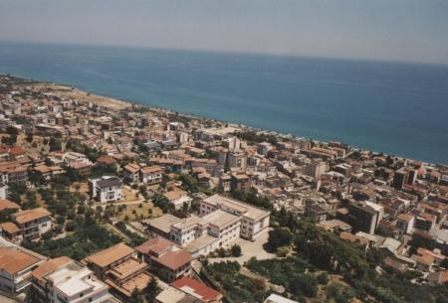
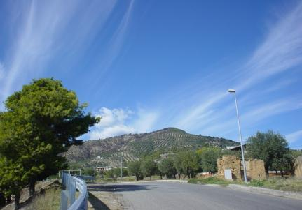
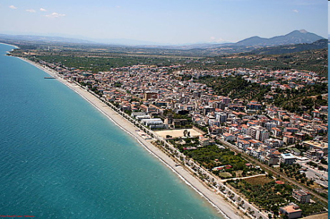
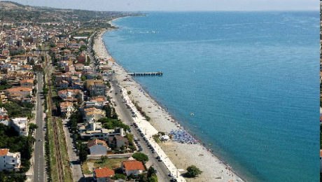

Arial views

Slide 9
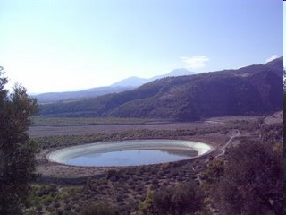
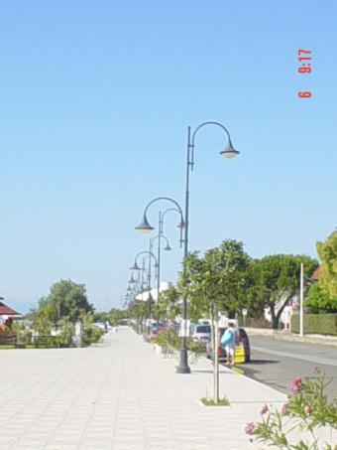
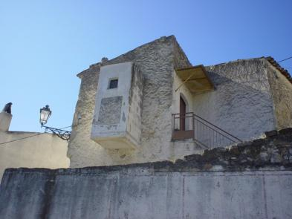

Slide 10
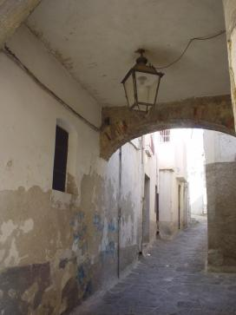
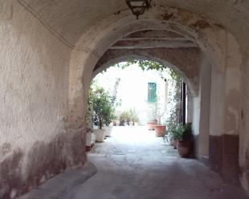
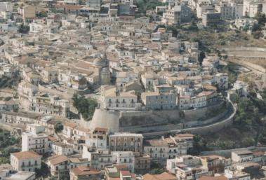
L’Arch ‘a fuchista
L’Arch’ da chiazza
A port da NNunziata

Slide 11
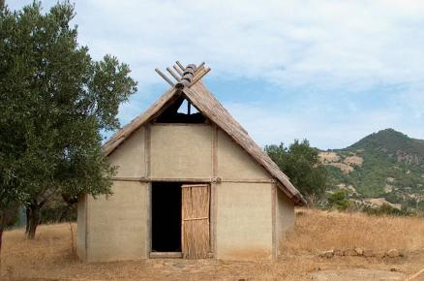
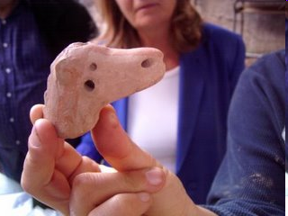
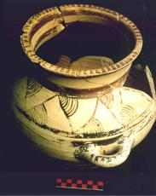
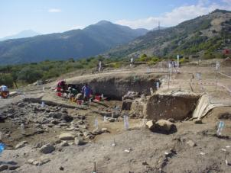
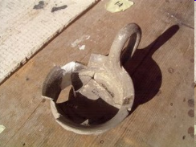
The site of Broglio

Slide 12
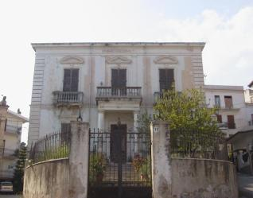
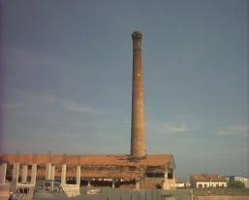
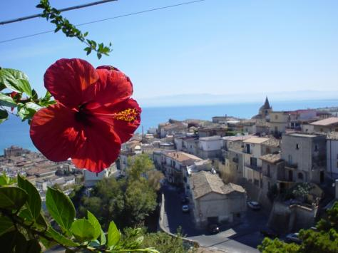
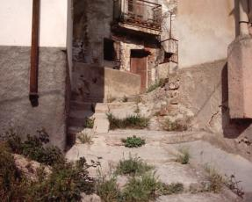

Slide 13
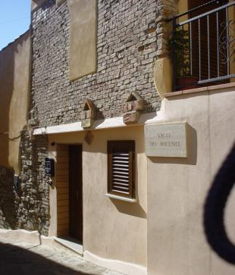
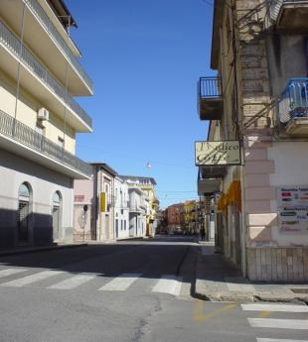
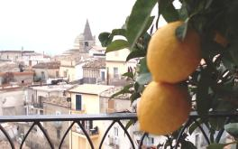
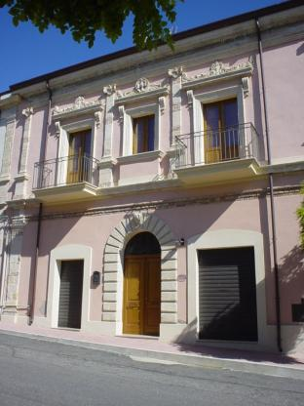
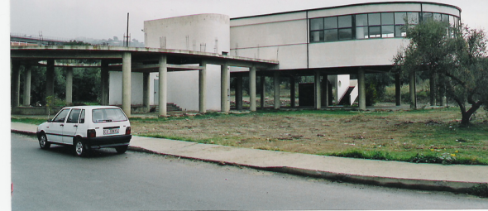

Slide 14


Slide 15
What we do
Età Serana aims to respond to the needs of adult citizens, people who are out the working and productive market .The association truly represents a point of social encounter for local people and new comers.
Età Serena encourages members that their knowledge, experience, competence and attitude is worth to be spent. It seeks to enhance the well-being of individuals, families, and communities through its constant work.

Slide 16
Among other objectives:
- to improve the quality of living to individuals, group and communities.
- to broad long life learning.
- to provide opportunities for an healthy, safe and enjoyable lifestyle.
- to promote diversity, inclusion, cultural competency, multiculturalism and social justice.
Età Serena offers courses, workshops, debates, seminars. It is active through various activities in the social network of the town of Trebisacce.

Slide 17
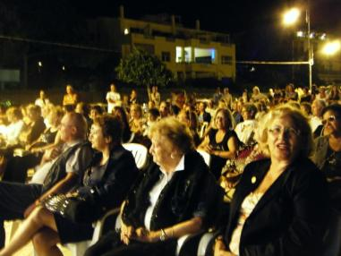

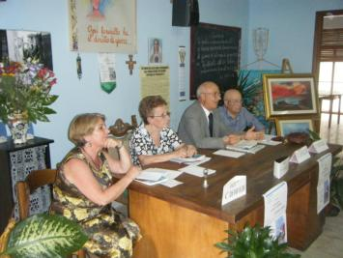
ETA’ SERENA
10 Giugno 2010
Presentation of the Novel
Il segreto uccello azzurro
by Giovanni Cataldi
Summer event
30 gennaio 2010
Via E. Torriccelli,10 ore 18.00
TREBISACCE
Presentano
SILVESTRO NERI
L’ in - canto DEL MITO

Slide 18
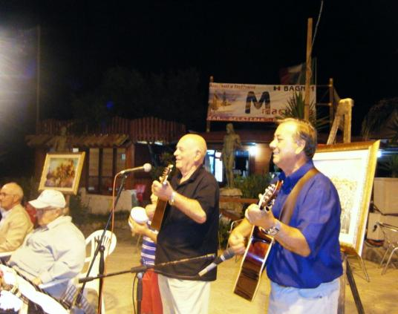
Recent events
A concert for chitarra, mandolino e voce
at the Sea Promenade,
on 3rd August , 2010

Slide 19
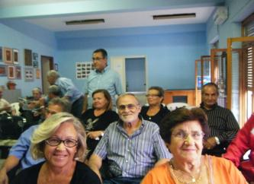
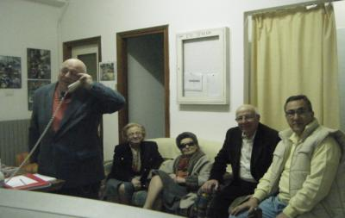
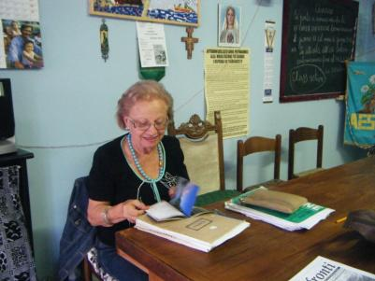
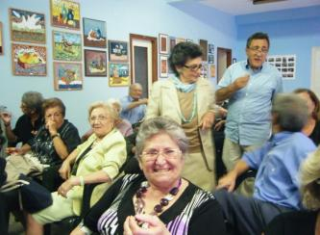
At work in the community room

Slide 20
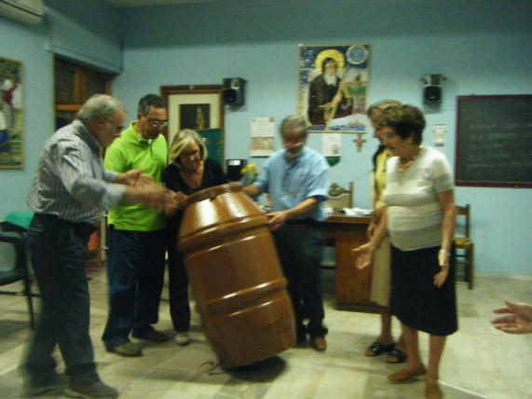
Reharsal
“La Giara” a commedy by Pirandello

Slide 21
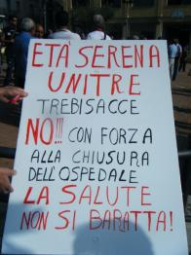
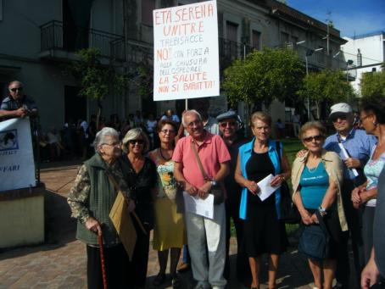
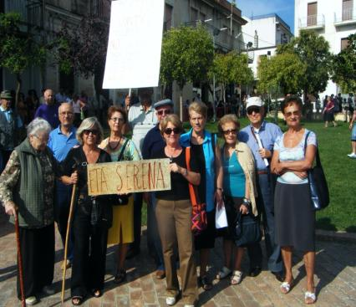
Social Concern
A sit-in for protest, against the closing of the local hospital, on 23rd September, 2010

