Slide 1
The Lithuanian Partner
Visaginas International Languages School - VILS

Slide 2
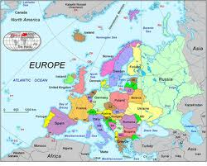

Slide 3
Interesting facts about Lithuania
By the end of the fourteenth century, Lithuania was the largest country in Europe.
Lithuania has 99 kilometres (61.5 mi) of sandy coastline
83.6% of the Lithuanian population are ethnic Lithuanians who speak the Lithuanian language
The 2007 estimated population was 3,575,439
Lithuania had only one king during the royal times, King Mindaugas
Lithuania was the last country in Europe to be converted to Christianity
Amber, formed by resin from ancient trees and insects in the resin, is found on the Curonian Spit.
National bird – stork
The Geographical Centre of Europe is 26 km to the North of Vilnius as it was found by The National Institute of Geography in France

Slide 4
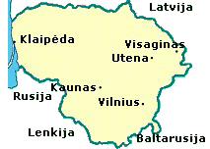
A little bit of geography
Boundary with Belarus and Latvia
Avarage temperature January -5o C, July +17o C
Area: 65 200 sq.km
Population: 3,3 million inhabitants

Slide 5
The Lithuanian language
state language and an official language of the EU
oldest surviving Indo-European language
Close relationship to Latin and Sanskrit
Studentas, ofisas, teatras, informacija, lapas

Slide 6
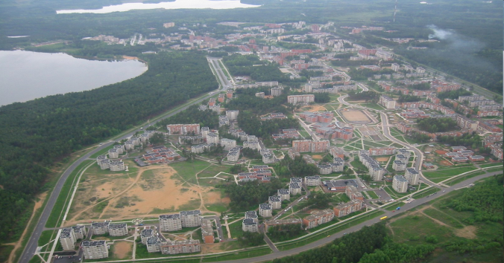
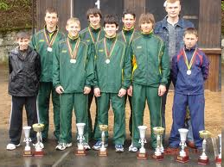
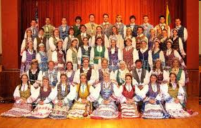
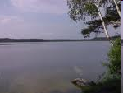
Home sweet home - Visaginas
The youngest town
The sportiest town
The most multicultural town
The greenest town

Slide 7
Alma Mater
1996
English, German, French, Russian
2,500 graduates
Determined staff
Experience in project activity
www.languages.dkd.lt

Slide 8
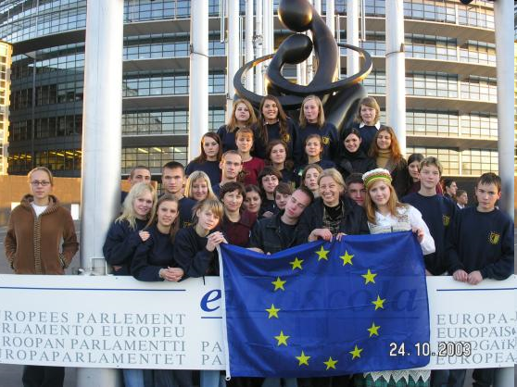
International experience
"Euroscola" competition
The Office of the European Parliament in Spain
tests relating to the Enlargement of the European Union
34 school teams different places of Lithuania
the main prize –participation in plenary, parties and committees in the European Union Youth parliament
32 students and 3 teachers

Slide 9
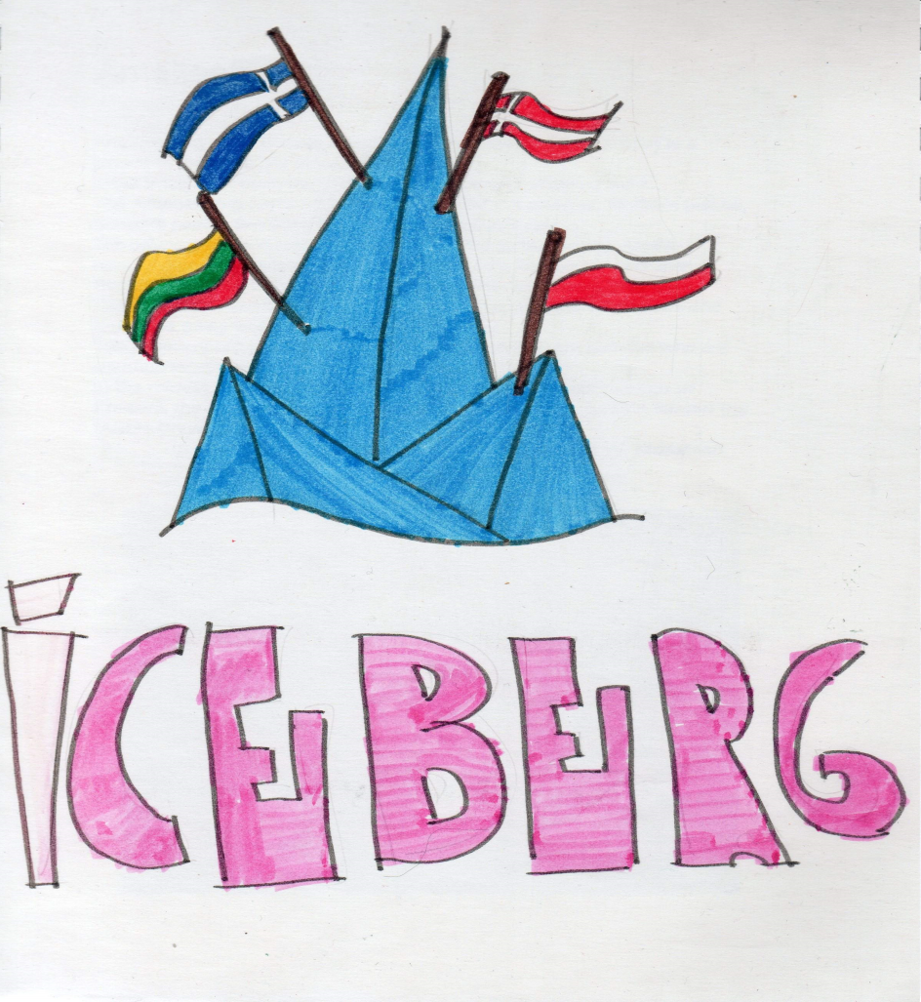
International experience
Cominius partnership project 2001-2003 ICEBERG
Co-ordinator: Denmark
Partners: Finland, Poland, Lithuania
End products: language survival kits, videos, games, booklets, calendars

Slide 10
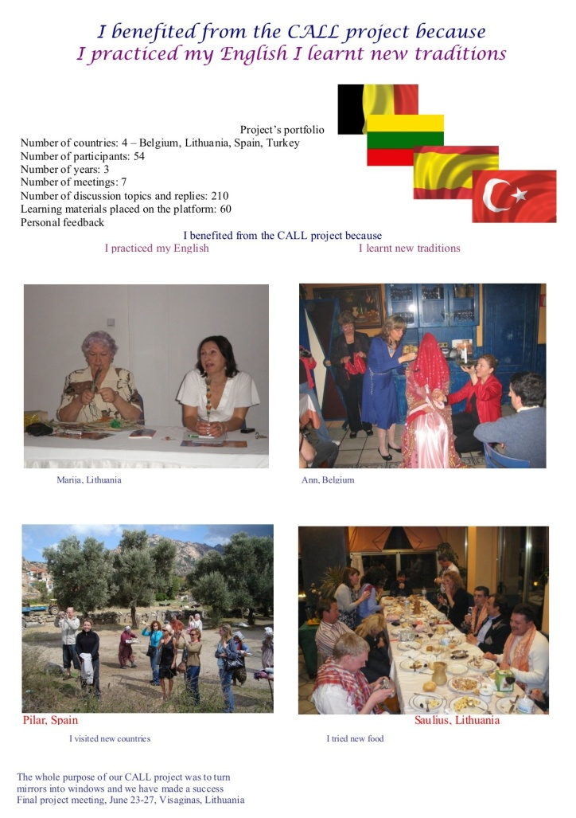
International experience
Grundtvig partnership project CALL
2006-2009
Co-ordinator- VILS
Partners: Belgium, Spain, Turkey
End product- learning platform, where students learnt English in a virtual classroom from partner institution teachers and from communication

Slide 11
Similiarities within ME(U)MORIES
Praha- descendant of Slavic tribes
Województwo Warmińsko-Mazurskie – the Baltic Sea
Länsi-Suomi – lots of snow
South-West Oltenia -non-formal and informal education
Region Calabria, Italy – woods
Arles, France- UNESCO World Heritage
Attiki, Greece- Orthodox
Severen Tsentralen, Bulgaria- multicultural

Slide 12
Draft activities map

Slide 13
Expectations from the project
A Magic Box

