Slide 1
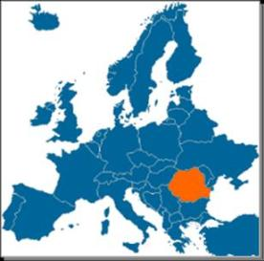
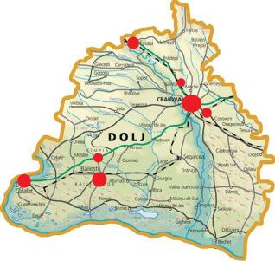
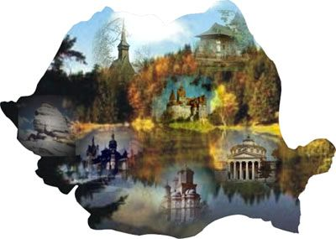
What about EDUNET?
Grundtvig ME(U)MORIES project
Meeting in Praha
6-10 October 2010

Slide 2
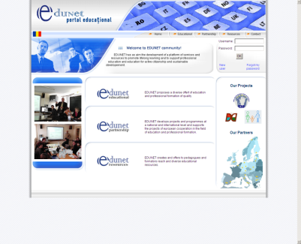
THE AIMS
The aim of the EDUNET organization is to make a platform of services and resources for the promotion of lifelong education, for supporting professional education, the education for active citizenship and for lasting development
EDUNET proposes a diverse offert of education and professional formation of quality.
EDUNET develops projects and programmes at a national and international level and supports the projects of european cooperation in the field of education and professional formation

Slide 3
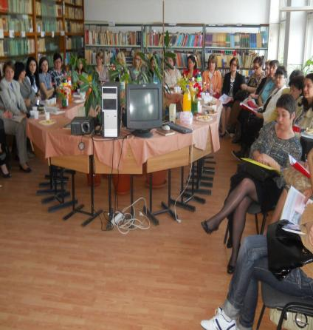
EDUNET EDUCATIONAL
EDUNET develops some offers of non-formal and informal learning:
Activities of training and developing the key activities at youngsters, specific to a society of knowledge;
Activities of supporting the adults for achieving the abilities and competences necessary to personal development and for professional integration and active citizenship;
Activities of supporting the vocational education and training of quality and the transition from school at active life;
Solutions of learning foreign languages and of training and developing the digital competences;

Slide 4
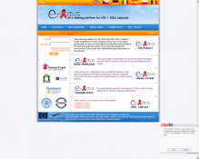
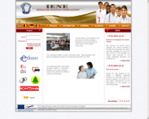

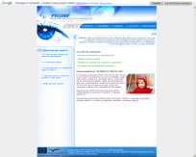
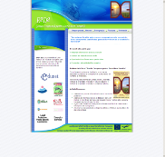
EDUNET RESSOURCES
EDUNET offers a variety of rich educational resources for trainers and course participants such as:
Creating an educational portal and an e-learning platform;
Creating educational software;
Editing books and publications;
Creating and publicizing didactic materials;
Our wesites
www.ieneproject.eu
www.e-aids.ro
www.edu-net.ro
www.edu-net.ro/PROMIP
www.edu-net.ro/E2D2

Slide 5
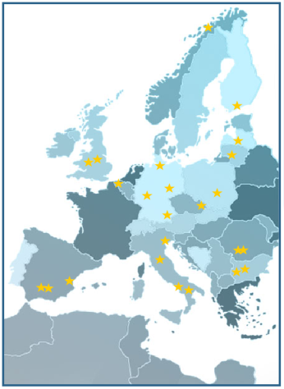
EDUNET PARTNERSHIP
EDUNET develops national and international educational projects and programmes
Projects of development and transfer of innovation in the educational field;
Projects of promoting the active European citizenship based upon the understanding and abiding the human rights and democracy and which encourage the intercultural dialog, to know and respect other European nations and cultures;
Specific projects for increasing the social cohesion;
Specific projects for supporting the persons and institutions from disadvantaged areas and from the rural area.

Slide 6


Our projects
LLP - Leonardo Learning Partnership:IENE-Intercultural Education of Nurses in Europe
LLP - Grundtvig Learning Partnership:PROMIP - Promoting Migrants' Participation
LLP - Grundtvig Learning Partnership:European School for Sustainable Development (E2D2)
LLP - Grundtvig Learning Partnership:Parents' aggression: Look at yourself - parents toward situations causing aggression
LLP - Grundtvig Multilateral Project:
E-AIDS - An e-learning environment for HIV/AIDS education
LLP - Leonardo da Vinci - Mobility Project:Developing new professional competences for the students from the Agricultural Schools
LLP - Grundtvig Learning Partnership:
ME(U)MORIES
LLP - Grundtvig Workshop: Virtual Library for promoting the European Heritage
LLP – Leonardo Transfer of Innovation:
IENE 2 -Intercultural Education of Nurses in Europe

Slide 7

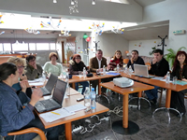

www.ieneproject.eu
The project adresses nurses being in European mobility or in traineeship placement and nurses working in contact with patients with different cultures and languages.

Slide 8
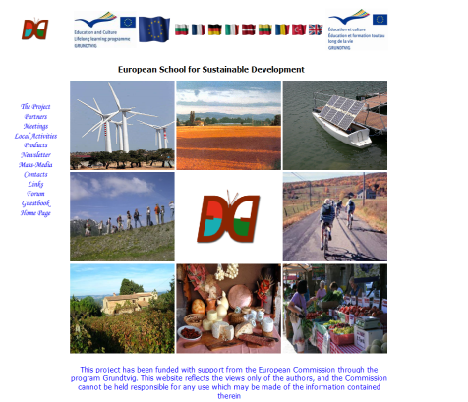
E2D2
OBJECTIVES
To promote economically and environmentally sustainable development
To use local historical, cultural and linguistic resources as a great value for the European cohesion.
To help and encourage the local community to develop their region.
Results
A handbook with examples of best practices from each partner country
www.edu-net.ro/e2d2

Slide 9
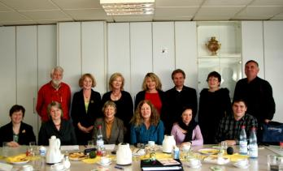
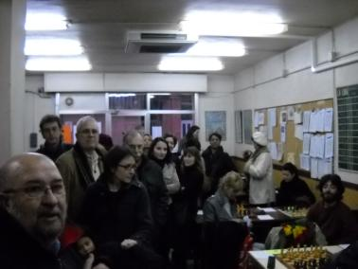
PROMIP
The PROMIP-Lerning Partnership focussed on the issue of migrants' participation in the host countries. The main objective of the partnership was to find out what are the encouraging aspects and hurdles/impeding factors for the participation of migrants in the host society.
www.edu-net.ro/PROMIP
Beramí, Frankfurt, Germany
www.berami.de
Amics de la Unesco
Barcelona ,Spain
www.caub.org
Ingrian Cultural Association
Helsinki, Finland
http://www.inkeri.com/
Adult Education Centre,
Tromsø , Norway
http://voksenopplaringen.tromsoskolen.no/
Adult Education Centre in the Northern
Region of Münich, Germany
www.vhs-nord.de

Slide 10
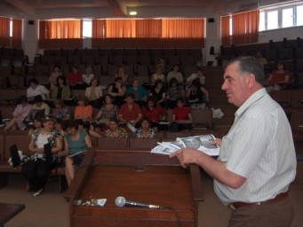
Virtual Library for promoting the European Heritage
  Dates : From 04/04/2001 to 09/04/2011
  Place:Craiova, Romania
  Language : English
  Target group(s): Adults having basic computer skills.
Each participant will create a virtual book of presenting the local heritages from its country. The books will be sent to the other participants by e-mail. The participants will add the books to the Virtual Library and evaluate them by adding notes.
A Virtual Library of the European patrimony will be created on the wiki website. The participants will upload their created books on the wiki page. They will make comments and communicate on the wiki space.
During the tree study visits, the participants will collect information about the local heritage: architecture, art, culture, history and landscape.
GRUNDTVIG WORKSHOP

Slide 11
ME(U)MORIES
The MU(U)MORIES project deals with senior citizens, promoting their active role in a local community, helps them to get up to speed with digital technology, improves their language skills and develops cross generation activities. The project activities will enable two different generations to better understand one another and to promote both Community and European spirit.
Within the Memories project, EDUNET wants to provide seniors citizens with ICT training, especially courses for grandparents with the aid of their grandchildren, and organize social activities to engage the seniors both in the modern , digital world and in the social community life.
EDUNET will cooperate with various public and private schools and non-governmental organisations in the region.

Slide 12
Local partnership
Teachers’ training
center
Strategic partner
organizing training
on ICT
Municipal Librairy
Strategic partner
Organizing educational
and cultural activities
Kindergardens
Educational activities
Collecting memories
Making books
Loacal partnership
History Museum
Strategic partner
organizing educational
and cultural activities
Primary schools
Educational activities
Collecting memories
Making books
Voluntary NGO’s
Strategic partners
Helping in organizing
ICT and lingvistic training
and books
Secondary schools
Educational activities
Collecting memories
Making books

Slide 13
keebook
facebook
Wiki space
created books
Proposed tools
EDUNET have proposed to use some work and communication tools in our project.

Slide 14
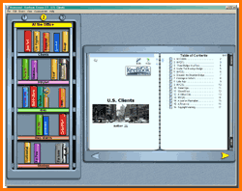

Keebook
The Keebook software which make virtual attractive books. We developed a previous project and trained to use it more than 200 teachers from our county.

Slide 15
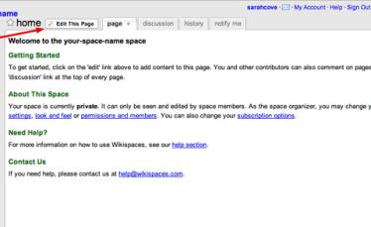
Wiki space
  The wiki space, a free website for the communication of the target groups and for putting the created books.
  Wiki URL : http://wikispaces.com/
  Romanian Wiki page:
  http://memories-ro01.wikispaces.com

Slide 16
FaceBook
The Facebook, a most popular social virtual community, which can be used for the communication among our learners from all the countries and from wide world.
Joining a Group
A Group can be a space for participants to share their opinions and interest around a specific subject. Anyone on Facebook can be join a Group. They can join Groups by browsing categories on the Groups main page or by typing a name in the search field.
We are invited to join our ME(U)MORIES group

Slide 17
Yahoo group discussion to be used for the communication among the staff and for posting projects documents, work in progress documents and outputs on the group web site available for the group Such a tool was very useful in the previous project because it allow to send easily the messages to all the partners and all the messages are kept in the archive. The archive of documents will be useful for the final report, too
The ME(U)MORIES Group was already created by Edunet .

Slide 18
Thank you for your attention!
Romanian team

